Slide 1
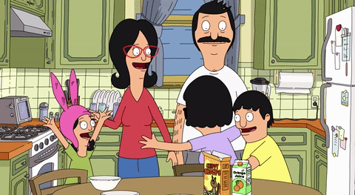
We are family.

Slide 2
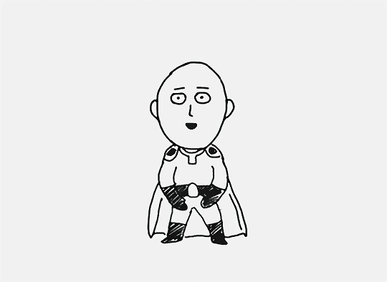
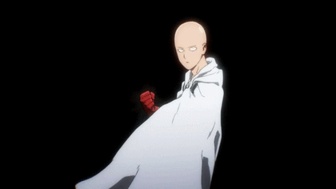
Did you finish your homework?
Sure thing!

Slide 3
Find the contractions of the Verb TO BE.

Slide 4
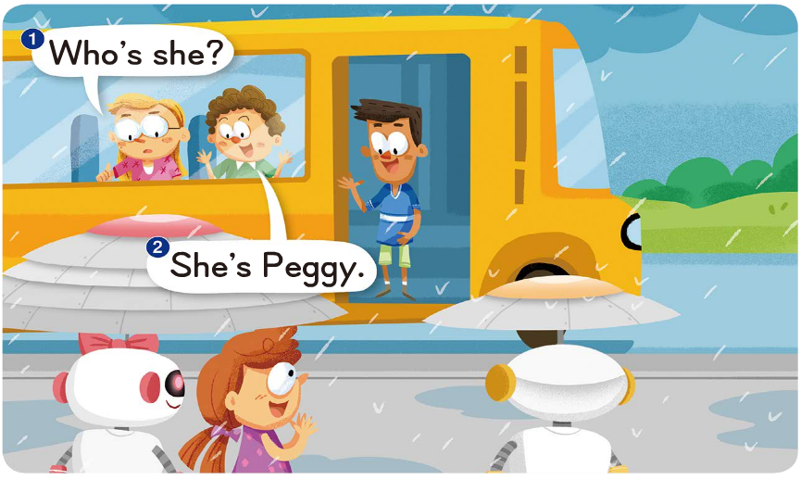
Who is
She is

Slide 5
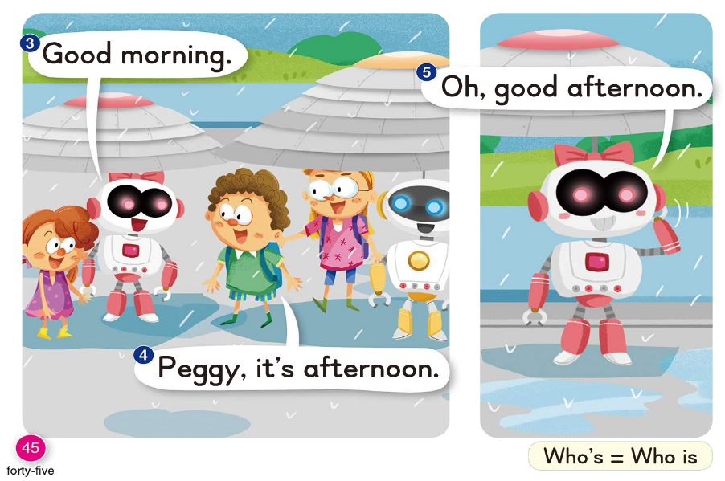
it is

Slide 6
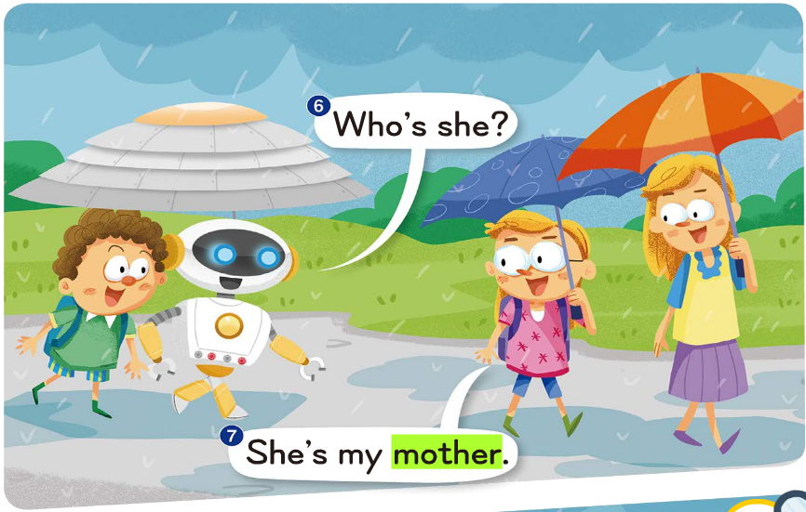
Who is
She is

Slide 7
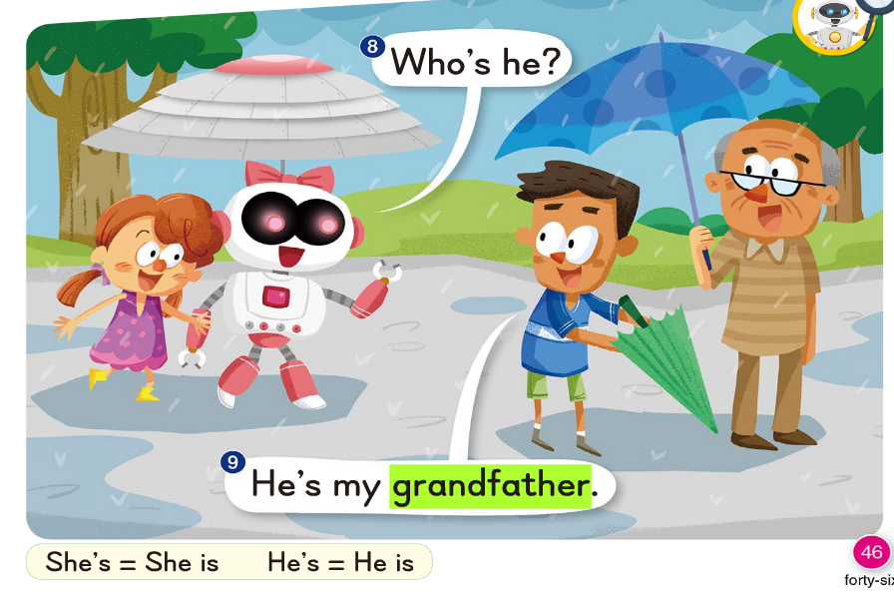
Who is
He is

Slide 8
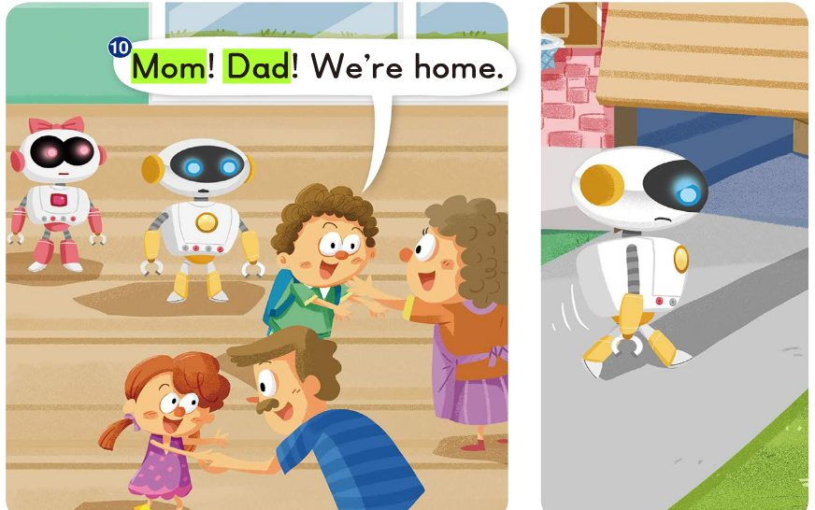
We are

Slide 9
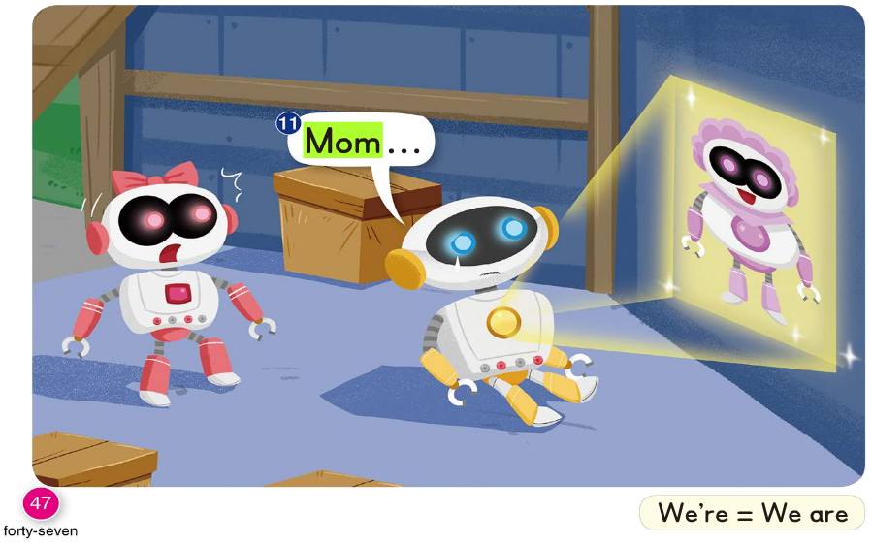

Slide 10
She is
She is
you are

Slide 11
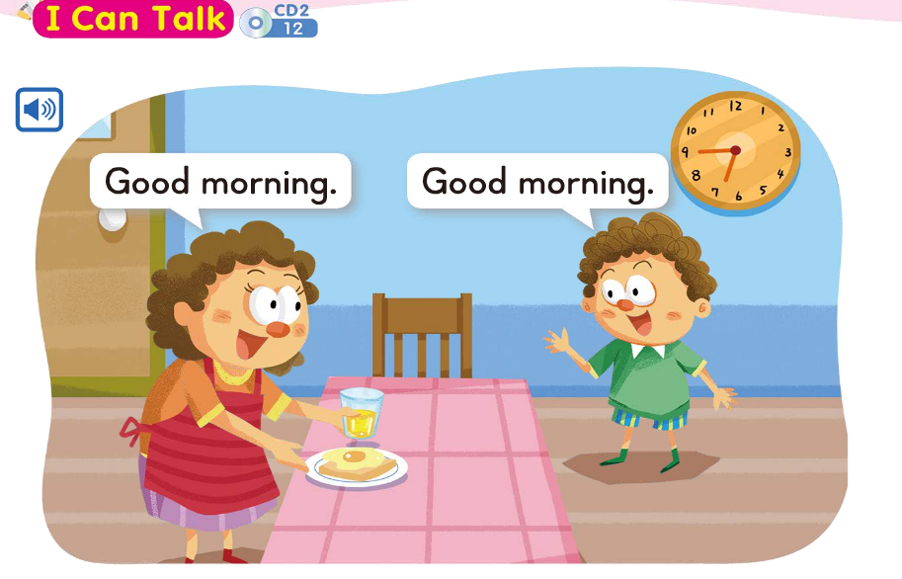

Slide 12
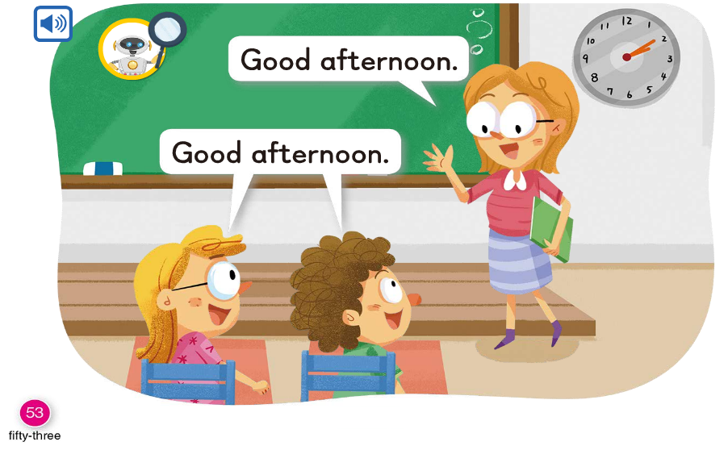

Slide 16
-op
-ot

Slide 18
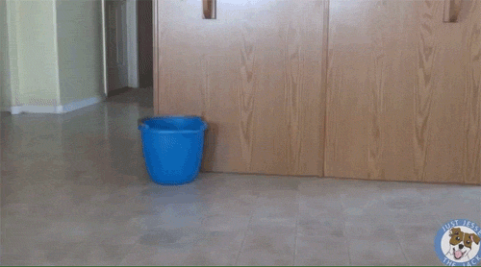
m
op

Slide 19
h
op

Slide 20
t
op

Slide 22
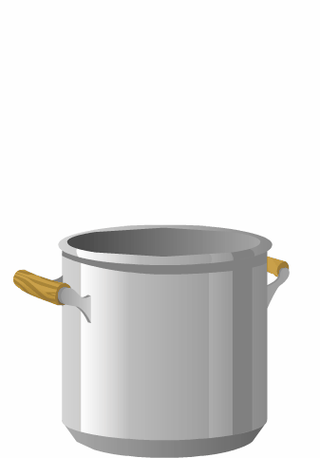
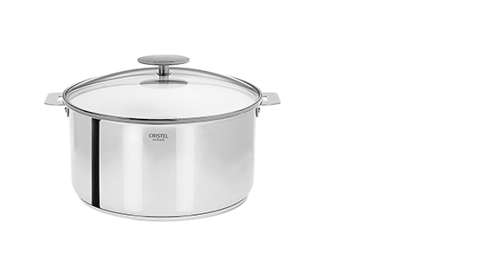
p
ot

Slide 23
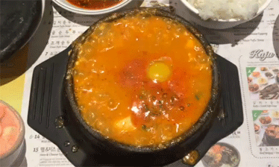
h
ot

Slide 24
n
ot

Slide 27
op
ot
mop
hop
top
pot
hot
not

Slide 28
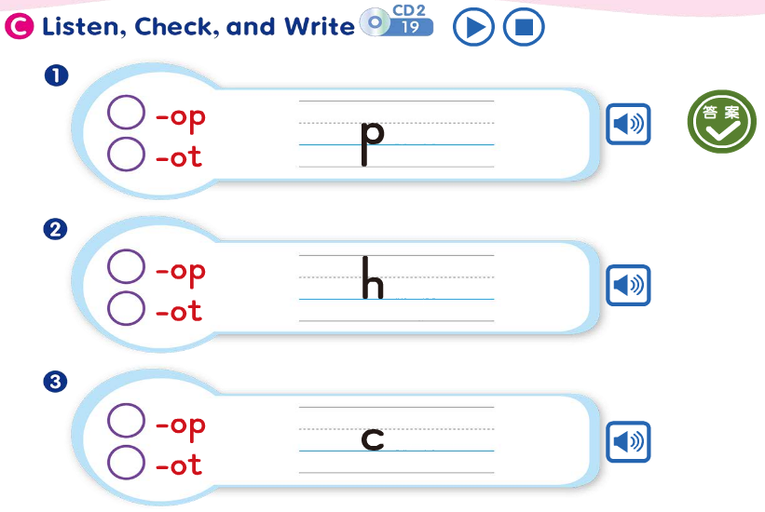

Slide 29
Bob can hop.

Slide 30
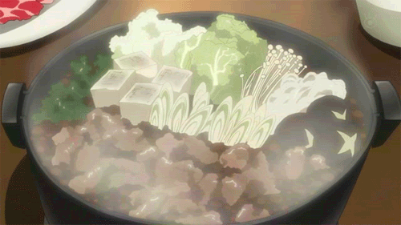
The pot is hot.

Slide 31
Bob can hop to the top
of the mop.

Slide 32
Bob can hop.
The pot is hot.
Bob can hop to the top
of the mop.

